Slide 1

Panel Review and Centres
One none or both

Slide 2
Institution wide or centres?
Centres may be known by another name, it’s abstract. It’s grouping.
Institution (Code)
Institution (Code)
Centre 1 (East Sussex)
Centre 2 (Kent)
Centre 3 (West Sussex)

Slide 3
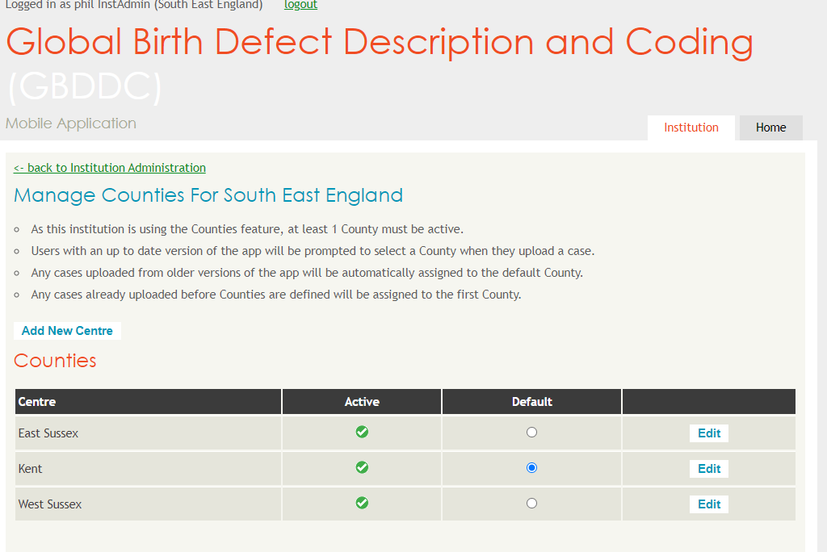

Slide 4
Centres (Counties in this example)
Users of the app register as a centre as well as an institution (code)
Unlike the institution code, the centres requires internet access to work, a user of the app will be prompted to update their details before uploading if they registered without internet access. For older versions of the app pre dating the centres feature a default is set online.
Centres work as a sub level of institution.
The county “Kent” is a geolocation subset. An app user registers as Kent and when the data is uploaded we know how to separate the data.
Triage and panel review can be set to the Institution level or centre level. Admin privileges can also be separated this way.

Slide 5
Triage
Triage user A
East Sussex
West Sussex
Triage user B
Kent
Triage user C
Kent
OR if Institution wide
Triage user D (for whole institution)

Slide 6
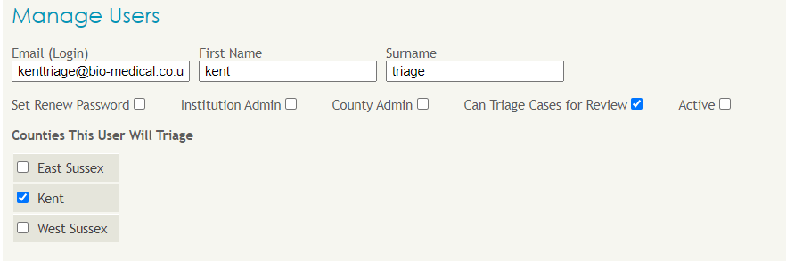
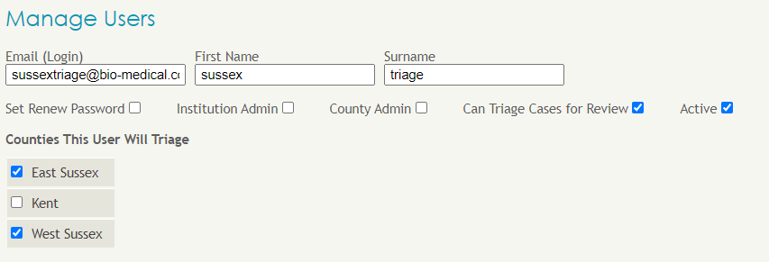

Slide 7
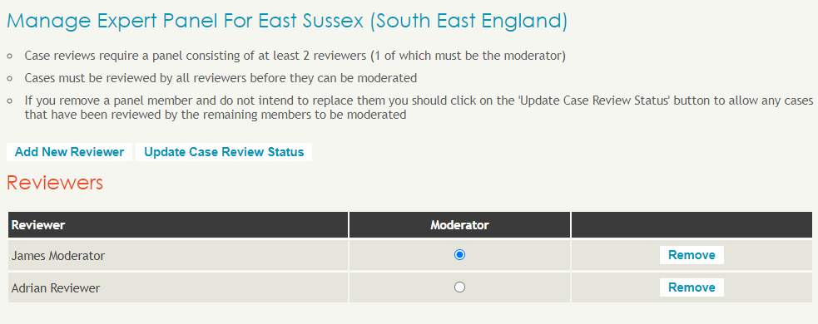
Panel Review (setup)
Institution wide or centres works the same.
Admin needs to setup the reviewers, one of which is also the moderator. Minimum 2. (Reviewers typically do not belong to your institution as users but can)

Slide 8
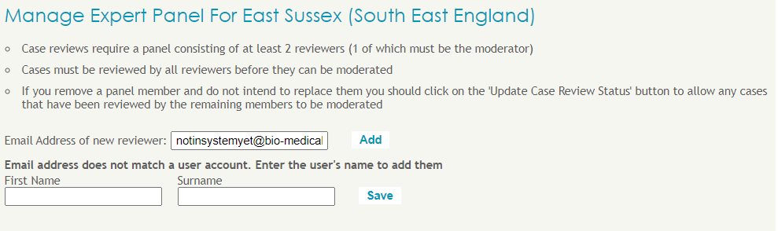
Reviewers
Reviewers are invited to a panel using an email address. Please ensure you have permission/agreement first.
If they exist in the system they will be added automatically.
Otherwise enter their email and name and they will be invited to join.

Slide 9
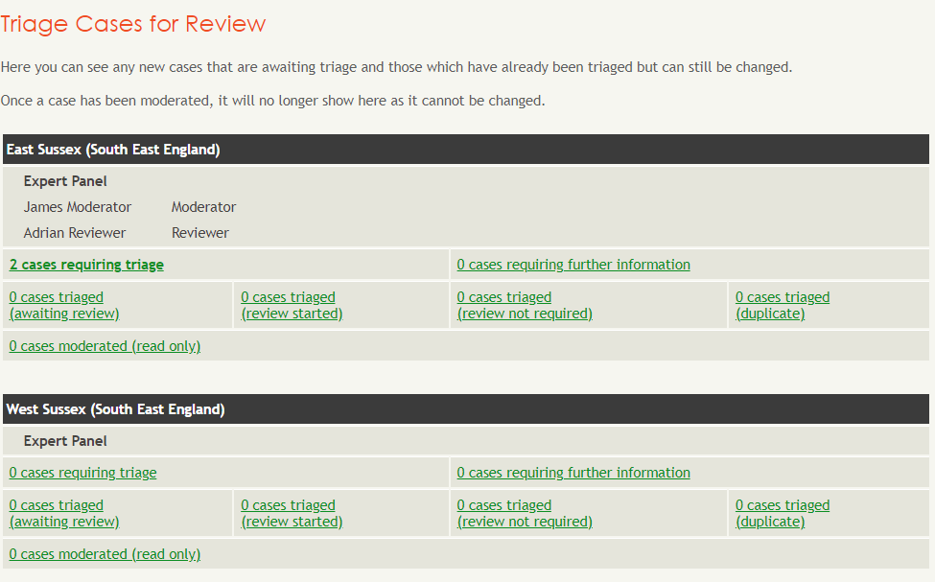
What you see as a triage user

Slide 10
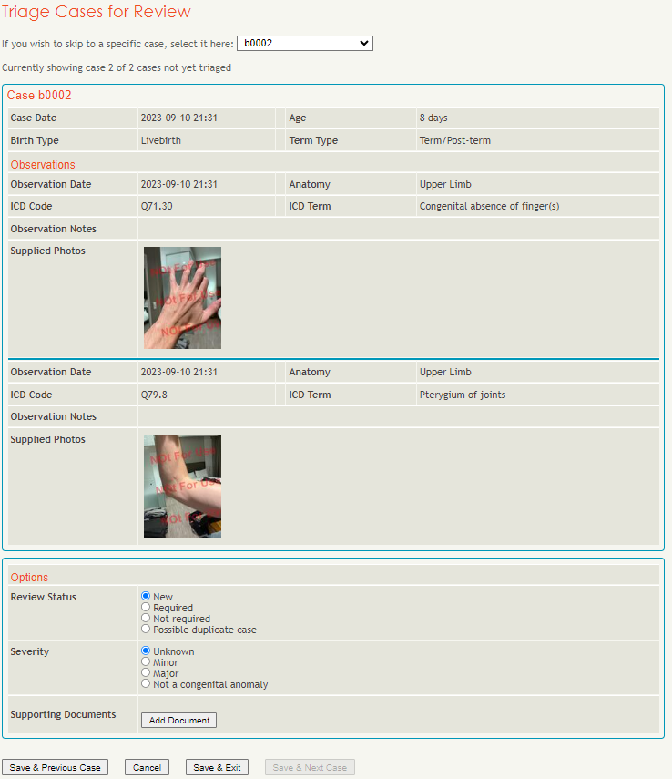

Slide 11
Triage review status
New (waiting for triage to review)
Required (Case will appear for reviewers of relevant panel)
Not Required (case will be ready for admin to download and delete)
Possible Duplicate (same as not required but also marks as possible duplicate)
Severity
Add document (a number of supporting documents can be uploaded, images, pdf, docx etc)

Slide 12
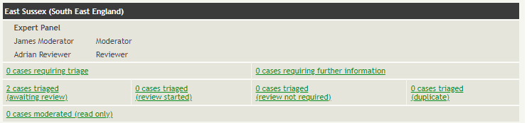
Triage view when both cases set to required

Slide 13
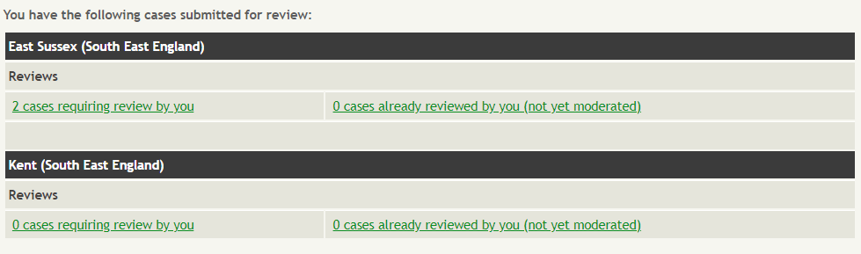
Reviewer logged in
This reviewer in on panels for East Sussex and Kent (2 centres)
2 cases currently requiring review

Slide 14
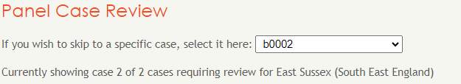
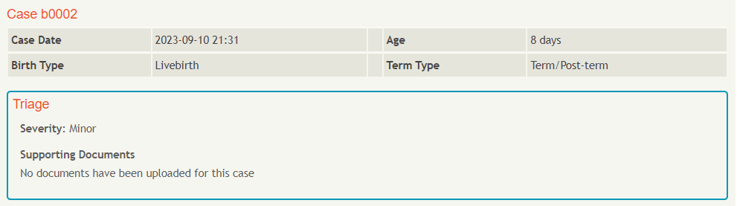
Reviewer logged in
Drop down list for each case
Cas details and triage selections

Slide 15
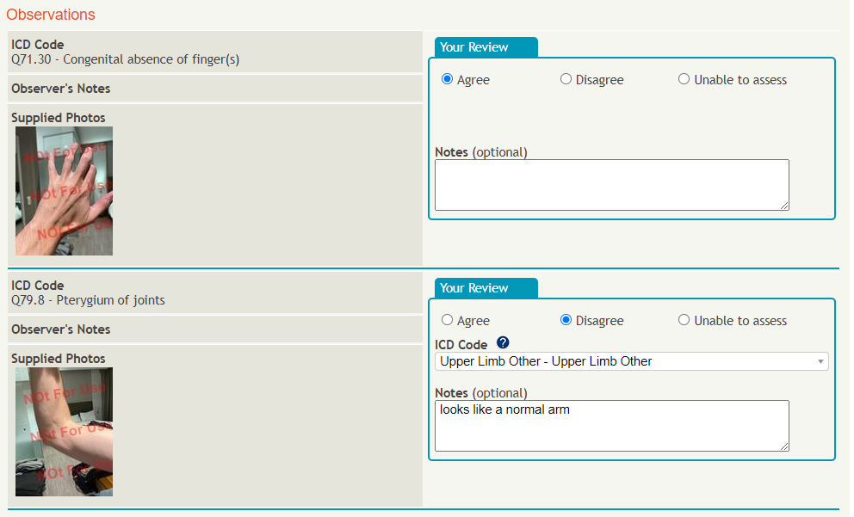
Reviewer logged in
Agree, disagree, unable to assess and add notes

Slide 16
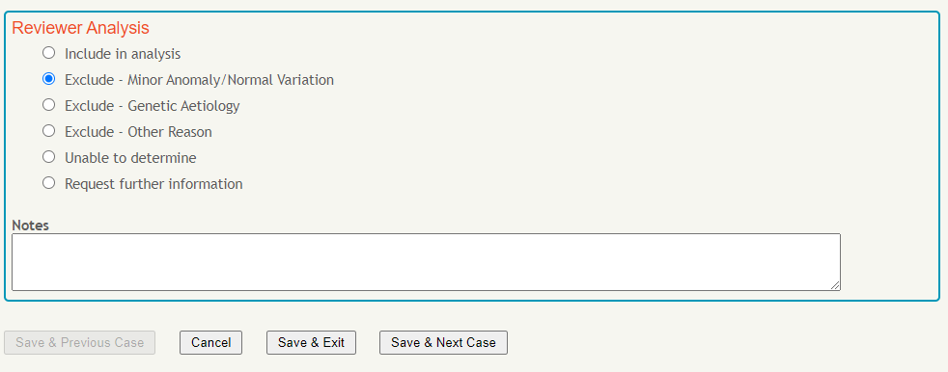
Reviewer logged in
Reviewer sets their opinion as to whether include or exclude from analysis

Slide 17
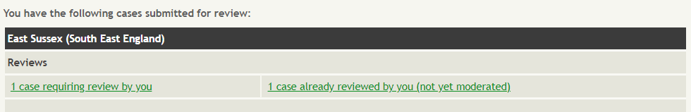
Reviewer logged in
After the case is reviewed and saved we now have one case this reviewer has reviewed and one they have not

Slide 18
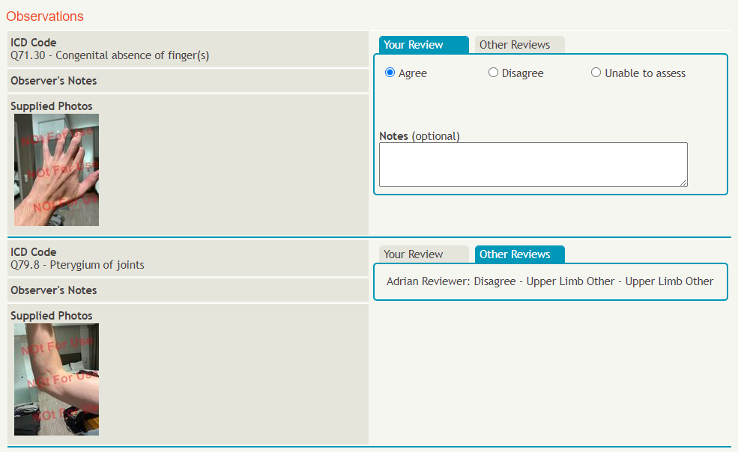
2nd Reviewer logged in
This reviewer sees the same as the other reviewer except now has access to previous reviewer’s selections

Slide 19
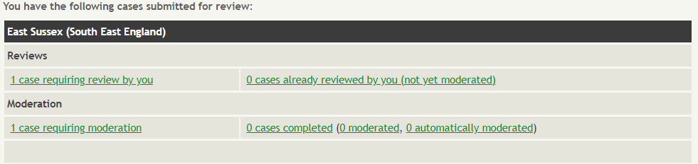
2nd Reviewer logged in(example is also moderator)
When all reviewers have reviewed a case it moves into “Moderation”
If all reviewers agreed on icd codes for all observations of a case, and analysis, then it may automatically be moderated.
In this example we need to manually moderate. Get a teams or zoom call going with all reviewers and the moderator will share their screen

Slide 20
Logged in as Moderator(who also reviewer 2 in this example)
For each case, moderate all observations, confirm icd code (this may or may not have been the code original selected by the app user or the code changed by the reviewers)
The icd code dropdown has a smart search feature, just start typing the code or words from the short description.
After all observations moderated for a case, provide final analysis review and add any notes then save. This will complete the panel review process for the case and the institution admin can download the final data and delete from the online system.

Slide 21
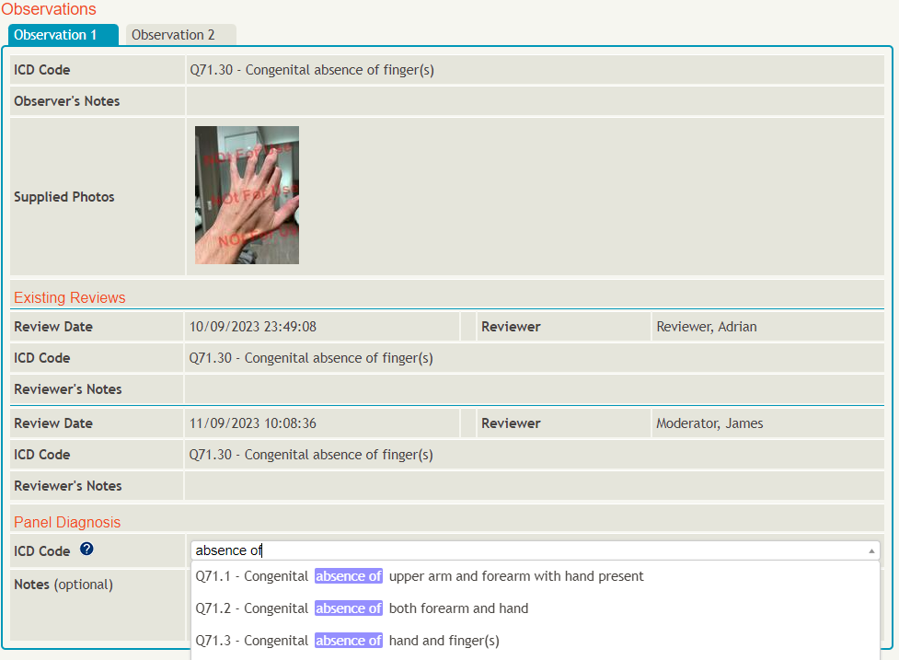
Type any part of icd code or the short description

Slide 22
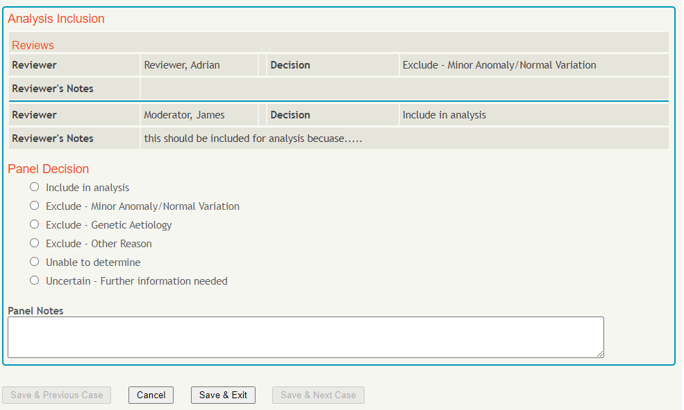
Finalise whether to be included in analysis

Slide 23
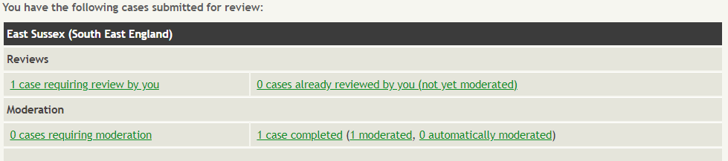
Logged in as moderator
The case is now in complete stage, the moderator will still have access to the case until the institution admin has downloaded and deleted form the system.

Slide 24
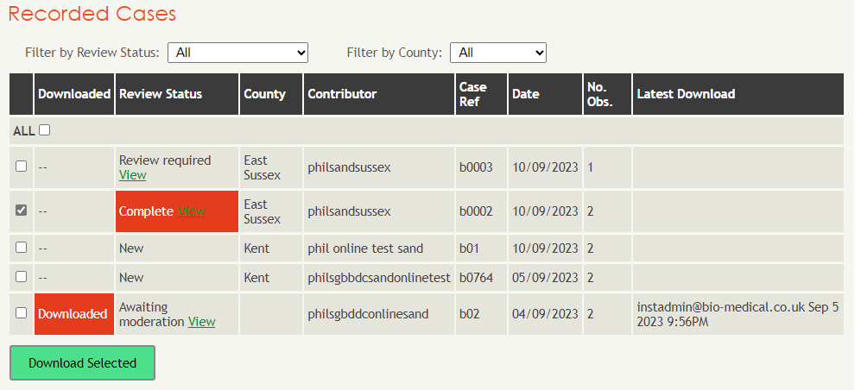
Logged in as Institution admin
The case we just reviewed and moderated can now be downloaded in its final state. Please verify it has been downloaded without issue and delete from the online system.
The case we just moderated, tick the checkbox and download with any others that are ready

Slide 25
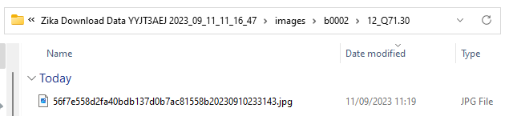
Logged in as Institution admin
Whilst cases are still on the online system , they can be downloaded, it is up to you to manage the data from here.
You will receive the data in an excel spreadsheet with photos and videos separated but identified with unique identifiers within the case e.g. 56f7e558d2fa40bdb137d0b7ac81558b20230910233143.jpg

Slide 26
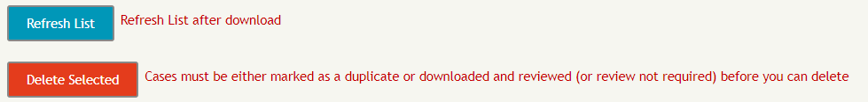
Logged in as Institution admin
After confirmation of download files, refresh the list and those marked red for downloaded and red for completed can now be deleted from the online system.
Once deleted the cases are completely removed from the system and will no longer show to any reviewers.

Slide 27
Conclusion/further development
That concludes the lifecycle of the review platform.
We are constantly adding features to the online platform and application
The next feature currently in development is a sandbox mode, a limited trial of the app and online platform.

